Slide 1
TunerFish
Project Updates
Chris, Gwin, Gavin
Notes:
Hello, my name is ___, [Other group members] and I have a couple updates for our tuning project: TunerFish

Slide 2
What We’ve
been working on

Slide 3
Note History

Slide 4
History Feature
Changes:
from using SQL to Json
Data type for Note in History is changed to String
No HistoryFeature and History Classes

Slide 5
Pseudocode
Saving Data from Tuning Feature to list of Events Objects => serialize into a .json file
Deserializing said .json file into list of Events Objects
Create DataTable using said list
Load DataTable into DataGridView

Slide 6
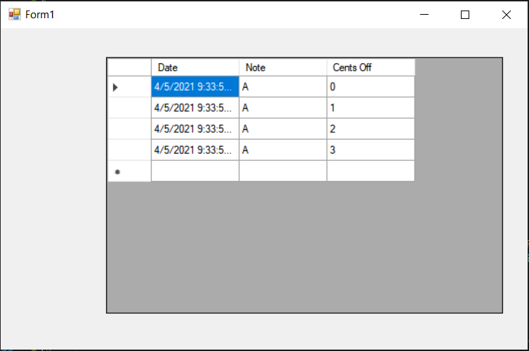

Slide 7
Note Player

Slide 8
Note Player
Changes:
No longer need Note and Note Player Class
Notes can simply be played by using .wav file

Slide 9
Audio Analysis
Notes:
Chris is presenting this one

Slide 10
Audio Analysis
What’s Working:
Real Time FFT display works
A rough approximation of what pitch is loudest

Slide 11
Audio Analysis
What’s Not Working:
FFT precision is really bad
Increasing the precision leads to slow performance

Slide 12
Audio Analysis
What needs to be made:
The rest of the tuner
Pitch table
Closest Note
CentsOff

Slide 13
Metronome

Slide 14
Metronome
Changes:
Tempo uses string instead of float.
String is converted to int so that it can be divided, that way the user can input tempo in BPM rather than milliseconds.
Division sum is stored as float, but converted back into int in order to be used for tempo.
Using while loop instead of bool.
Remaining:
GUI

Slide 15
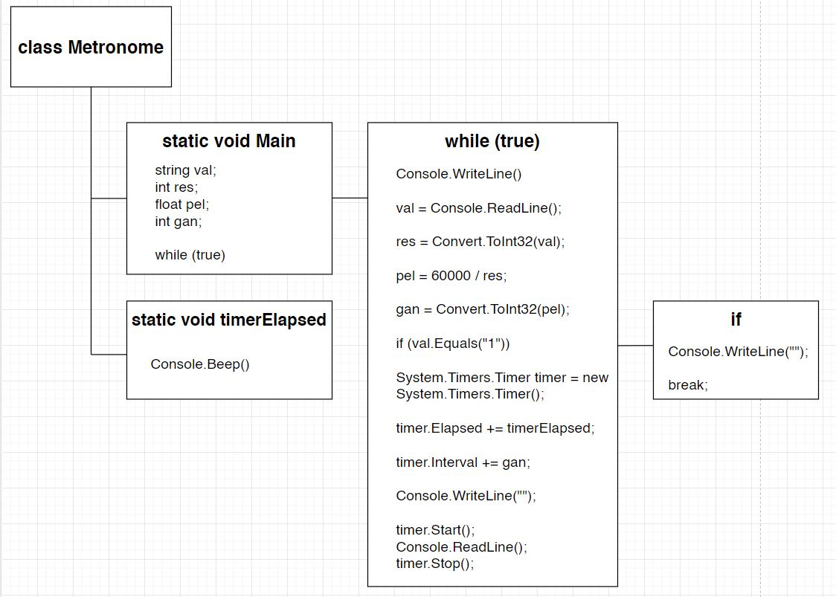

Slide 16
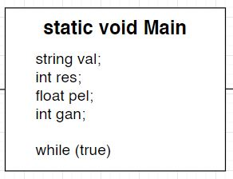

Slide 17
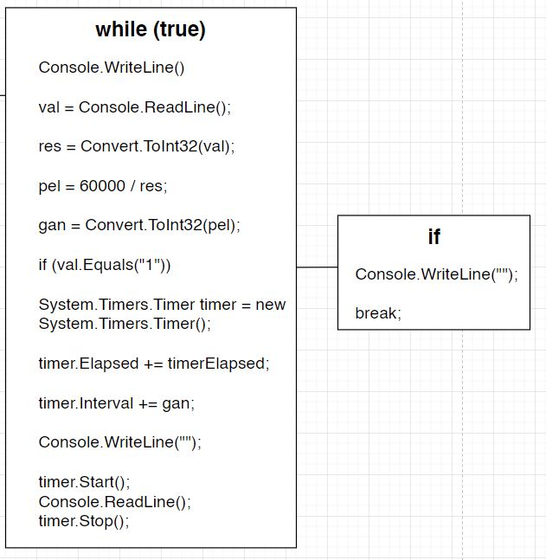

Slide 18
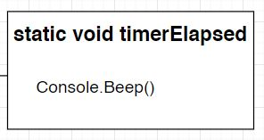

Slide 19
Pseudocode
Start metronome class
Start main method
Initialize variable string val
Initialize variable int res
Initialize variable float pel
Initialize variable int gan
Start while loop
Prompts the user to emter a tempo in BPM format or to enter 1 to exit
Read line and store as string val
Convert string val into int res
Divide int res by 60,000 (how many milliseconds are in a minute) and stores as float pel
Converts float pel into int gan
Start if statement for string val reading 1 as input
Display exiting message
Exits program
End if statement

Slide 20
Pseudocode Continued
Creates an instance for timer based off the system timer
Creates an event handler for timer
Sets the timer interval (tempo) using int gan
Prompts the user to press enter to re-enter a new tempo
Starts the timer
Reads the timer
Stops the timer
Ends while loop
Ends main method
Starts timerElapsed method and reference the timer object/instance and event handler
Produces a beep at a certain frequency and for a specific duration based on parameters
Ends timerElapsed method
Ends Metronome class
Notes:
add a closing slide - summary then a “thanks for listening”

Slide 21
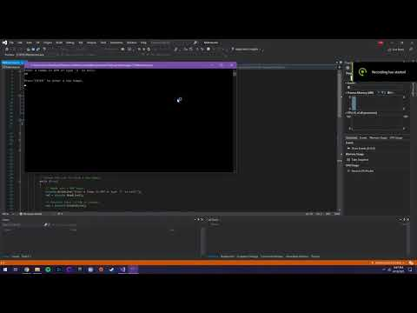

Slide 22
Thank you!
Questions?

